Slide 1
Applying a background image for a “Custom Certificate”
using MS PowerPoint
and LMS - Custom Certificates
October, 2021

Slide 2
Select “Design” from the menu strip
Then select “Page Setup”

Slide 3
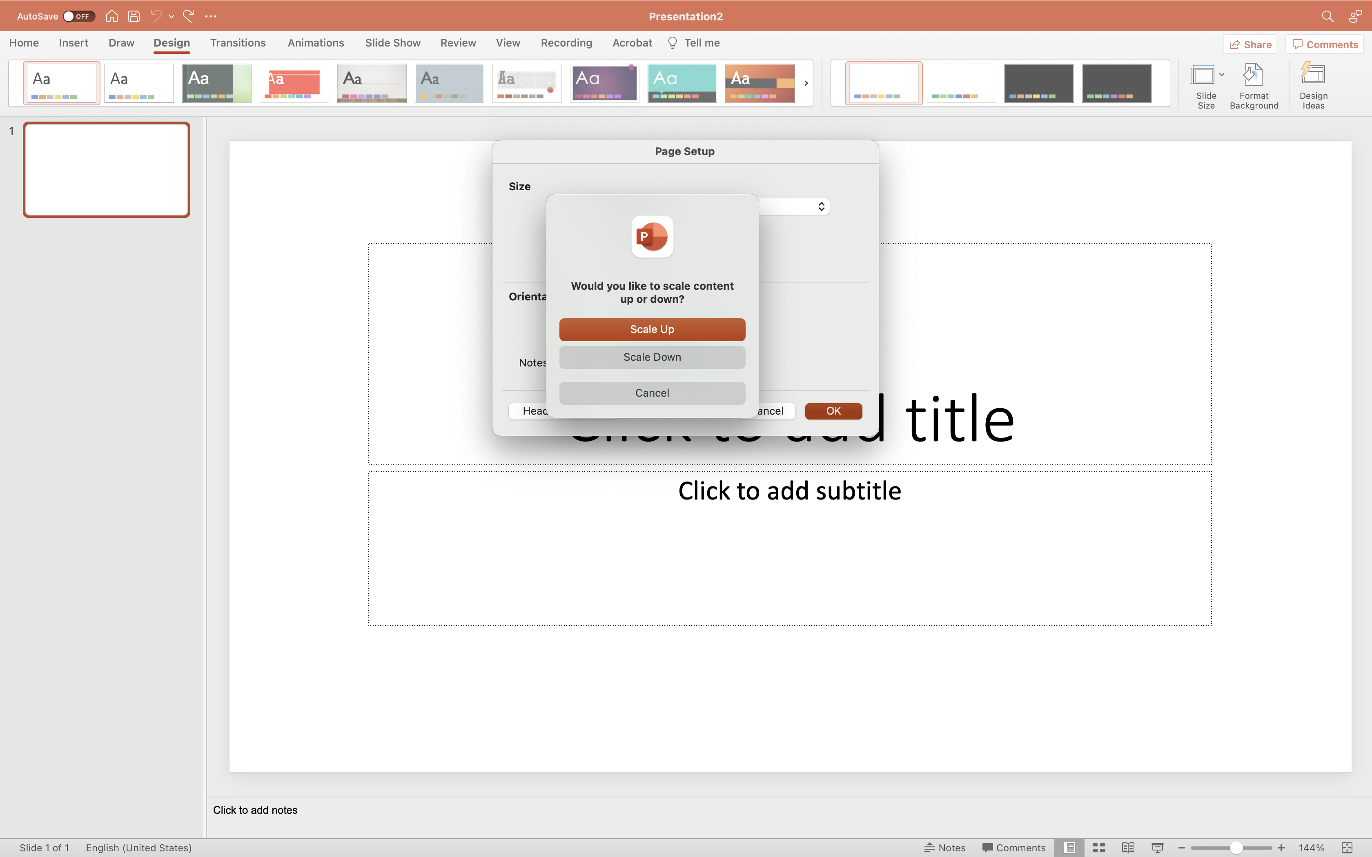
Change “Width” and “Height” to
desired dimensions
…8.5 in x 11 in
Then select “Scale Down”

Slide 4
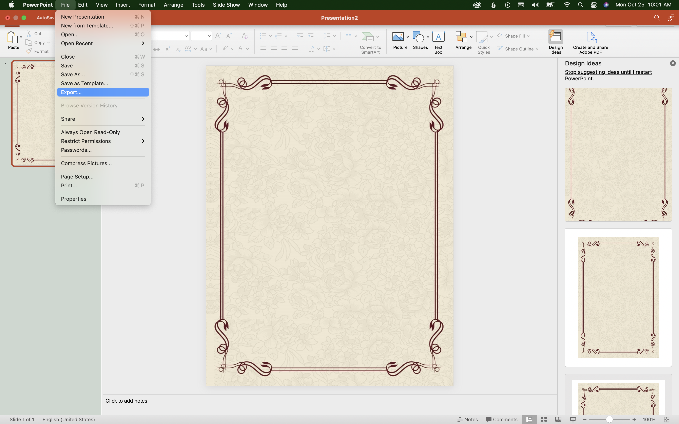
Create or Add image.
Scale to fit dimensions.
Export the slide as an image.
Recommend “.png” or “.jpg”

Slide 5
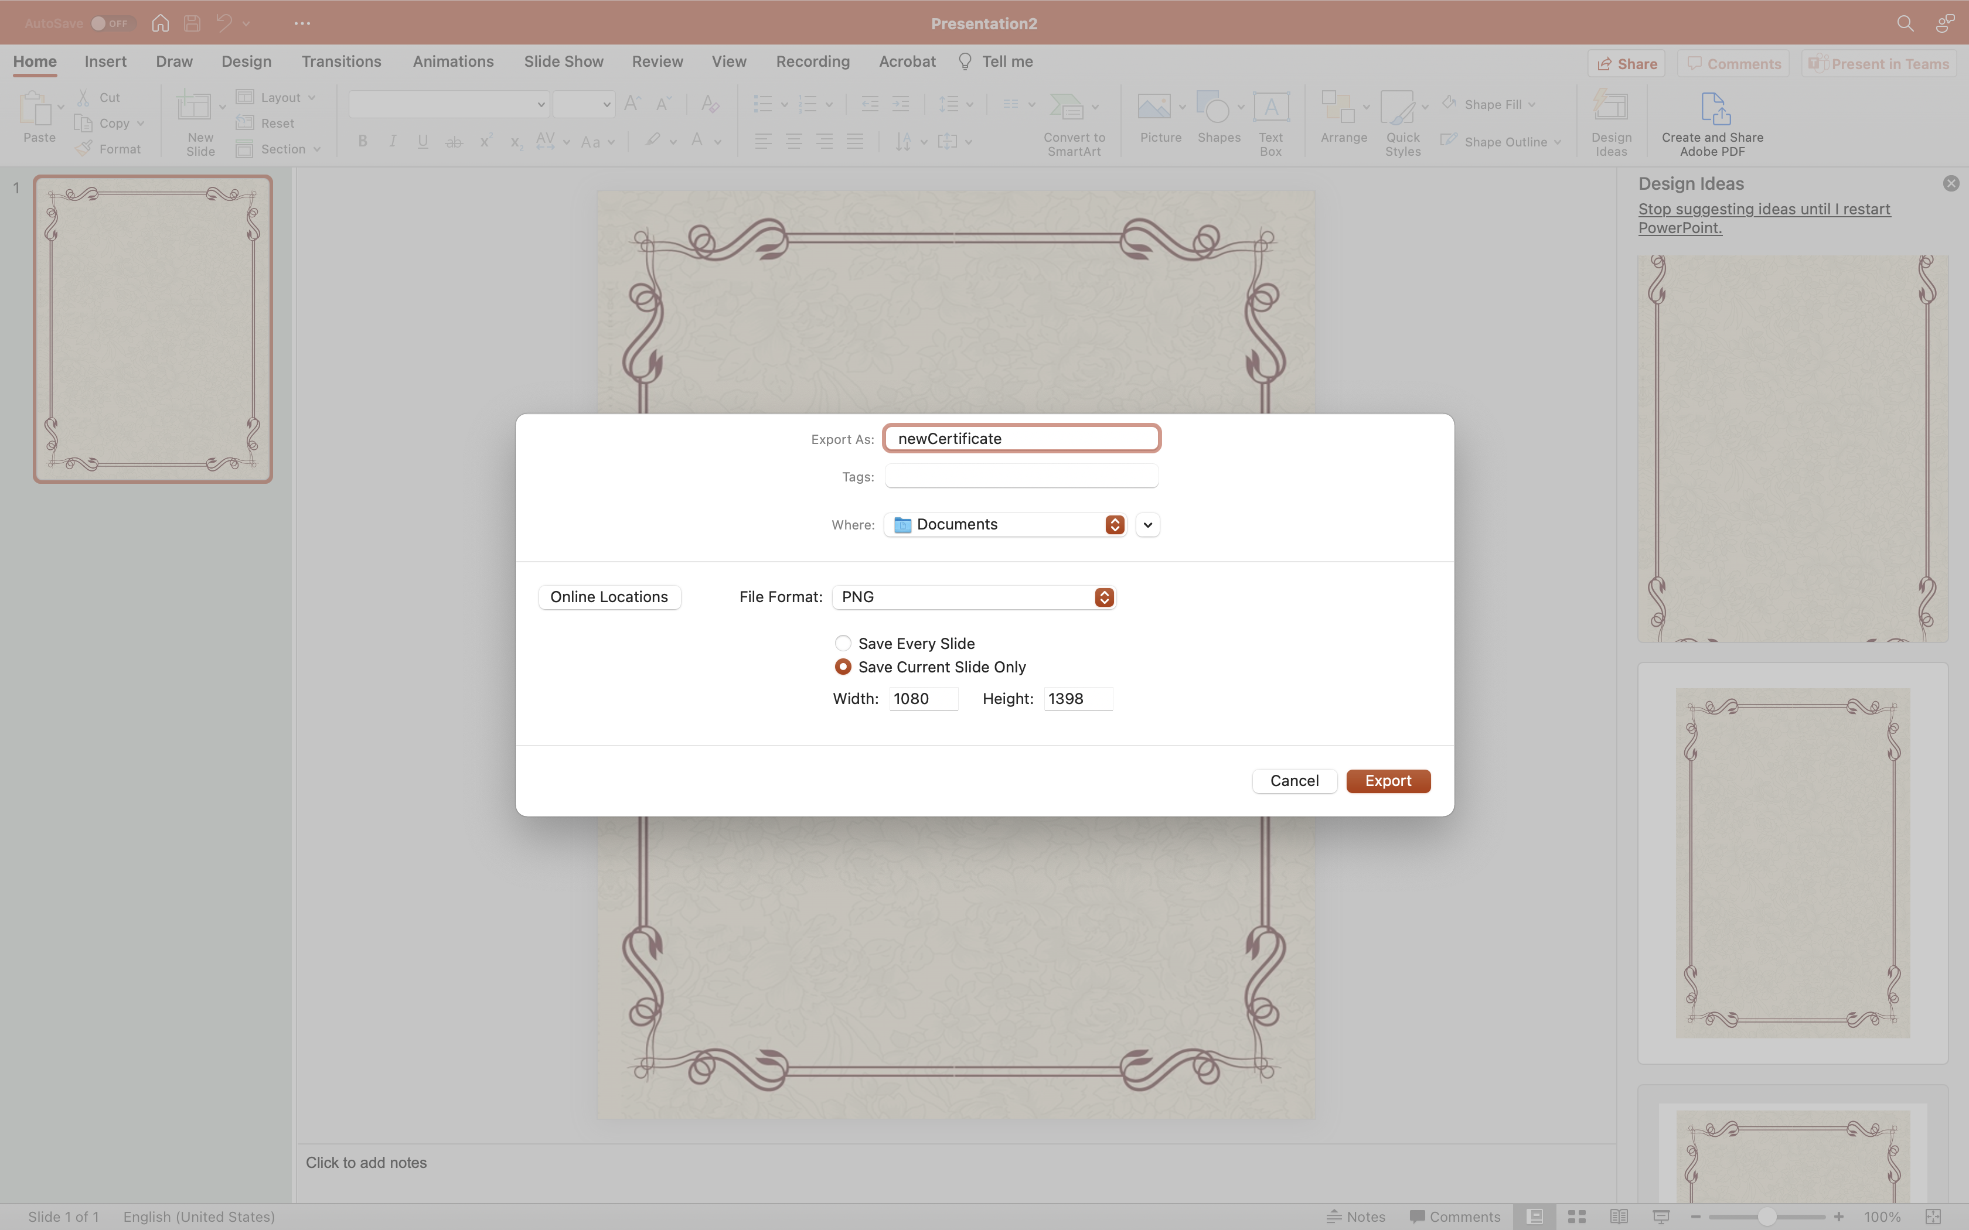
Save to preferred location
on your device

Slide 7
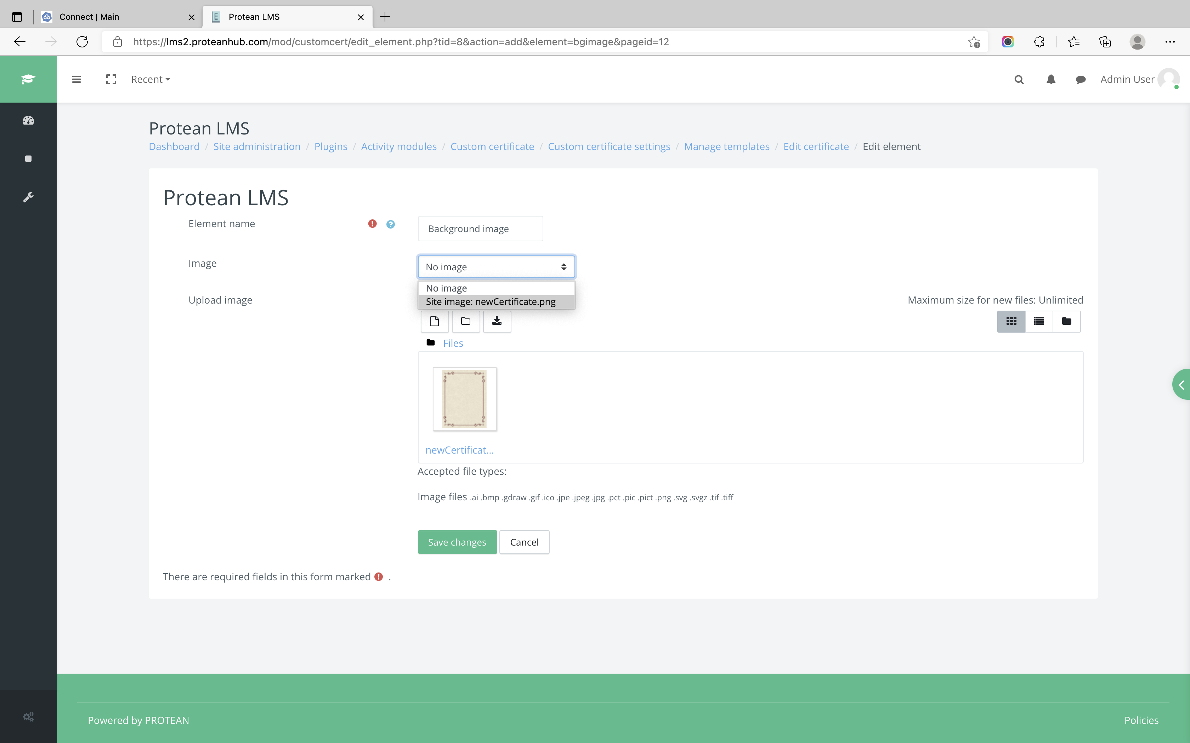
Create Template:
Custom certificates >
Manage templates
Upload image to “Files” AND apply “image” (select the image after uploading)…then ”Save changes”

